Slide 1
MARYLAND INFANTS & TODDLERS PROGRAM
Consolidated local
implementation grant (CLIG)
SFY 2019 Annual Grants Webinar
Wednesday, March 13, 2018

Slide 2
Application Submission
Due Date:
May 11, 2018
All Required Documents Are Available for Download at:
http://marylandpublicschools.org/programs/Pages/Special-Education/rmmb/Grants/IT/index.aspx

Slide 3

Ultimate Goals for Early Intervention
For children… to enable young children to be active and successful participants during the early childhood years and in the future in a variety of settings – in their homes with their families, in child care, preschool or school programs, and in the community.
For families … to enable families to provide care for their child and have the resources they need to participate in their own desired family and community activities.

Slide 4
Consolidated local implementation grant (CLIG)
The CLIG is designated as the primary grant mechanism through which local jurisdictions receive federal and State funds to implement local early intervention programs in compliance with federal and State regulations, policies, and procedures. As a result of participating in early intervention services, children show improved outcomes and programs achieve the ultimate goals for children and families.

Slide 5
Section 1 - Authorizations
DUNS number and screen shot of active Sam.gov registration
Local System Contact List
Federal Certifications Certificate
Local Interagency Coordinating Council (LICC) Review Statement
General Education Provisions Act (GEPA), Section 427

Slide 6
Section 2 –
Annual Plan Requirements
Documentation of Local Lead Agency Designation, if applicable
Local Interagency Agreement
Local Interagency Agreements Private Agency Attachment
Signed Assurance of Continuous Service
Local Interagency Coordinating Council Memberships and Meetings
Directing the Use of Funds: Linking Federal Funds to Program Improvement
Early Intervention Program Plan
Family Support Network/Preschool Partners
LITP Policies and Procedures

Slide 7
Local Interagency Agreement
Required pieces:
Assignment of financial responsibility for early intervention services;
Procedures for achieving timely resolution of intra-agency and interagency disputes about payments for a given service, or disputes about other matters related to the local early intervention system, including a procedure for notifying the MSDE/MITP when resolution is not possible;
A mechanism to ensure that no service that a child is entitled to receive under IDEA Part C are delayed or denied because of disputes between agencies regarding financial or other responsibilities;
A description of Medical Assistance (MA) billing procedures for health related services and service coordination including the role(s) of the partner agencies in the interagency agreement;
Identification of the local government agency/department that will provide legal representation of the local Infants and Toddlers Program when the program is involved in IDEA dispute resolution procedures;
Additional components necessary to ensure effective cooperation and coordination among all service providers involved in the early intervention system, including, but not limited to, the provision of timely and accurate fiscal and programmatic reporting;
This agreement, which should not expire before June 30, 2019; and
Any language in the interagency agreement that included infants and toddlers should be expanded to also include preschool children in the Early Intervention System of Services.

Slide 8
Private Agency Attachment
Contracting Agency | Private Agency Partners or Contractors | Services Provided by Discipline Including Service Coordination | Funding Mechanism (e.g. Contract, Direct-Billing of Medicaid, etc.)

Slide 9
Linking Federal Funds to
Program Improvement
Add Data To ALL Columns
Identify Patterns of Performance and Compliance/ Noncompliance
Complete Right Hand Column “Amount Of Funds Designated For This Indicator”
Provide A Short Narrative Of How Funds Will Be Used

Slide 10
 EARLY INTERVENTION PROGRAM PLAN
🤔 Infrastructure
  Data-informed decision making
  Consistent messaging
  Allocation of resources & supports
  Ability to manage change
🤔 Personnel
  Staff selection
  Training
  Coaching
  Performance assessment/fidelity
👉 Plan Sections:
   Improvement/Corrective Action Plan
   Public Awareness Plan
   Child Outcomes Summary Process
   Effective IFSP Development
  Comprehensive System of Personnel Development (CSPD)
  Plan

Slide 11
Early Intervention Program Plan
☛ Please use the questions in the System Considerations Table in each section of the program plan to address both the facilitators and barriers to full implementation in the primary areas of infrastructure and personnel development to guide the team’s root cause analysis and planning. The Early Intervention Program Plan Template (required), including data analysis tables, is included in the Attachments section.
Focus Area | Infrastructure Development Considerations | *Personnel Development Considerations
*Items in the “Personnel Development Strategies” column in each section of the EI PROGRAM PLAN must be included in your CSPD Plan.
  Helps ensure alignment between areas of the CLIG

Slide 12
Section I:
Local Improvement/Corrective Action Plan
For SFY 2017 data, IPs/CAPs were assigned in March 2018 and are due within 30 days.
Use the System Consideration questions to think about infrastructure shifts and personnel development needs.
It may be helpful to work on this section as you work on your IPs/CAPs as there is overlap.

Slide 13
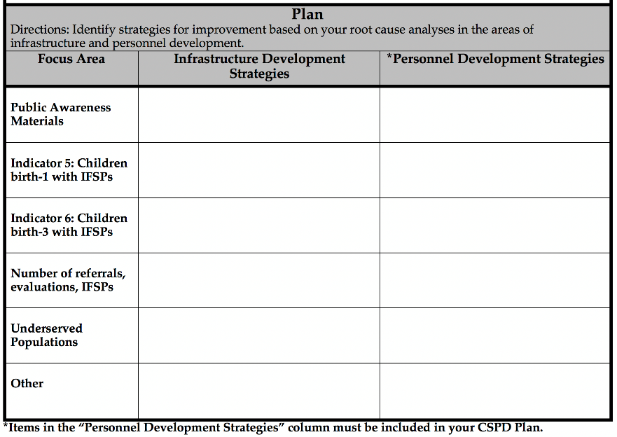
Section II:
Public Awareness Plan
Public awareness materials should reflect the overarching goals and routines-based nature of Early Intervention.
Data points include indicator data, child find
(referral, evaluation, new IFSPs), and underserved
populations.
General public awareness activities are “a given.” Think about additional infrastructure and personnel development factors impacting public awareness and access to the local early intervention program.

Slide 14
Section III:
Child Outcome Summary Process
Complete data table taken directly from your Annual Report Card.
Use the System Consideration questions to think about infrastructure shifts and personnel development needs.
Implementing the COS process with fidelity requires good authentic assessment, different than evaluation and then requires additional time for the information gathered to be age-anchored.
Therefore, one of the biggest shifts to consider is separating the evaluation and authentic assessment activities during the referral process and allowing time for the age-anchoring before developing the IFSP.

Slide 15
Section IV:
Effective IFSP Development
New IFSP document, process, and online tool – effective July 1, 2018.
Analyze 5 IFSPs for functional, routines-based outcomes.
Use the System Consideration questions to think about infrastructure shifts and personnel development needs.
The new IFSP process and document requires an evaluation for eligibility AND an authentic assessment. It must be either the Routines-Based Interview (RBI), the Scale for Assessment of Family Enjoyment within Routines (SAFER), or the natural routines and activities section of the IFSP.
Consider significant shifts in process, staffing patterns, and resources that can be supported by leadership and/or implementation teams.

Slide 16
Section V:
Comprehensive System of Personnel Development
Suitable Qualifications data
The CSPD Plan must include, where appropriate, training on the basic components of the early intervention system; the coordination of transition services from the ITP to Preschool Special Education services, or another appropriate early childhood program; and the development, implementation, and incorporation of educational outcomes in the IFSP to promote school readiness.
Professional Learning Opportunities must address S.Q. gaps, Personnel Development Strategies across all sections of the EI Program Plan, and any other relevant areas of need based on data.
Professional Learning Opportunities required components

Slide 17

SFY 2019 CLIG Family Support Network/Preschool Partners
Grant Requirements
Describe how Family Support Network and Preschool Partners operates in your local program, including activities.
Provide specific strategies to improve response rate and representativeness of the Family Survey.

Slide 18
Polices and Procedures
The MITP requires that a current version of your Policies and Procedures is on file.
If you have made changes since your original submission, please submit and updated version with your CLIG Submission.

Slide 19
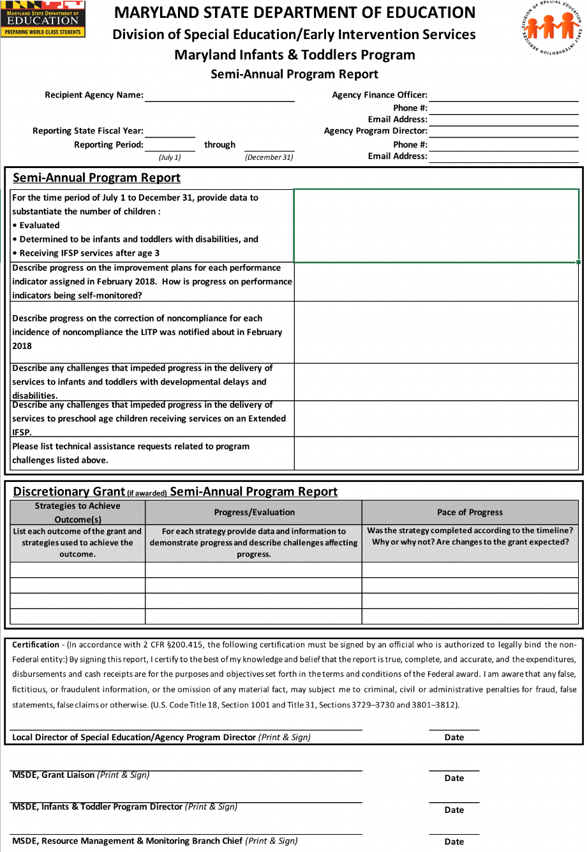
Semi-Annual Program Report
Fiscal and programmatic reporting have been separated again for SFY 2019.
The Semi-Annual Program Report will be due on January 31, 2019 for all grants.

Slide 20
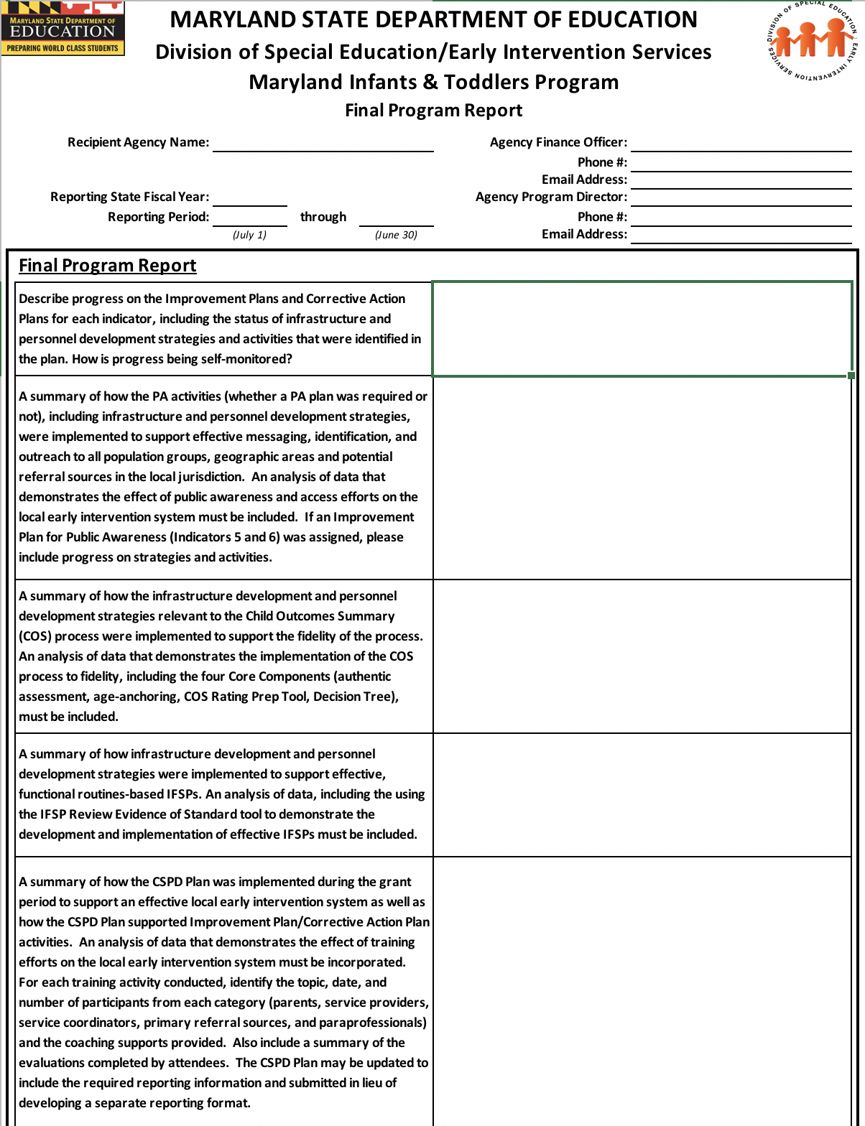
Final Program Report
For SFY 2019, this report will be due on November 1, 2019.
Programmatic reporting requirements will include all components of the Early Intervention Program Plan.

Slide 21
Application Submission
Due Date:
May 11, 2018
Use your MSDE Liaison for technical assistance in developing and implementing your plan. Consider sharing a draft of the plan prior to getting signatures to share ideas and feedback.

Slide 22
Special Funding support
  Available Funding for CLIG Grants Allocated to LITPs Based Upon Child Count and Referrals
  Decreased Funding Limited to 2%
  Supplementary Part B 611 Grant Line
  Fiscal Reporting - Interim and Final Cumulative Variance Report Forms
  Programmatic Reporting – Include in Semi-annual and Final Program Reports

Slide 23
Supplemental Funding on the NOGA

Slide 24
Part C Submissions Calendar
http://marylandpublicschools.org/programs/Pages/Special-Education/rmmb/Grants/IT/index.aspx
  Latest Submission Due Date Information
  Correct Versions of Documents

Slide 25
MSDE Secure Web Client
MSDE Secure Web Client Access and
Submission Procedures
      Access
      Uploading Procedures
      Single Document Per File
      File Naming Convention
      Maintenance

Slide 26
The Budget Submissions Workbook
ONLY Microsoft Excel - Windows Version - Compatible
The Entry of Information from Partner Agencies MUST Be Entered into a Single Copy of the Budget Submissions Workbook
Step-by-step Instructions in Section 4 of the CLIG Application

Slide 27
A Word about budgeting
LLA, in Collaboration With Partner Agencies,:
    Identifies Program Needs for Upcoming Year
    Produces a Listing of Expenditures to Meet Identified Needs
    Assigns Expenditures to the Appropriate Partner Agency
    Assigns the Expenditures to a Funding Source – Local, CLIG, or Federal Medicaid

Slide 28
The Budget Submissions Workbook
Useful LITP Funding Information:
The LITP Consolidated Budget Form 100 Includes Two Information Charts That Present The Percentage Of Fiscal Contribution By:
  Local & Other State, CLIG, and Other Federal sources; and
  Each of the partner agencies

Slide 30
What’s New in the SFY 2019 Budget Submissions Workbook?
  Federal MA Reimbursement Availability Worksheet – Form 100
  Description of Other Federal, Other State, and Other/Private Funds – Forms 100A
  Indirect Costs
  Program/Category 206 Unlocked on the C-1-25 Forms

Slide 31
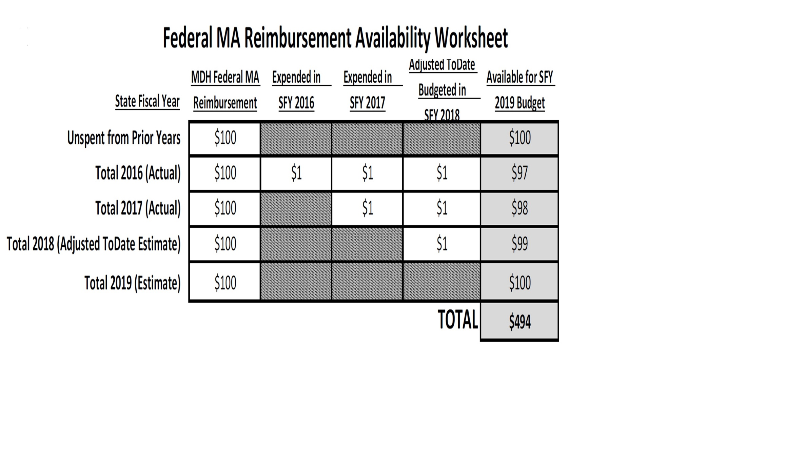
Federal Medicaid reimbursement availability Worksheet
Identifies Federal MA Funds Available for SFY 2019 Budget
Accountability of Funds By Fiscal Year

Slide 32
Form 100B Reminder
MITP Form 100B - Detailed expenditure information for Salaries & Wages and Fixed Charges

Slide 33
CLIG State funds & federal Medicaid
Allocation Delivered via Grant and Intergovernmental Transfer Payment from the MDH
NOGA Shows Initial Grant Amount and Estimated IGT Funds
Reconciliation of Estimated IGT and Actual IGT Can Result in a Revision of the Grant Amount and/or Invoice for Expenditure of Funds Above Allocation
Accounting Setup Facilitates Management of the State Funds and Federal Medicaid

Slide 34
Timeline for
CLIG state general Funds
June 30 - Obligate Entire State Infants & Toddlers Allocation
July 10 – Type 1 Report (Non-LSS Must Submit An Invoice) to COMPLETELY Expend The State Grant
August 31 - Based Upon The Reconciliation, The MSDE Issues NOGAs To Revise State Grant Approved Budgets And Invoices, as applicable
September 10 –Type 1 Report (Non-LSS Must Submit An Invoice) to COMPLETELY Expend The State Grant (if the Grant Amount was Revised)
September 30 – Final Financial Report To Account For The Final State Grant Approved Budget And Must Pay Invoice, if applicable
September 30 – Final Cumulative Variance Report Of The ENTIRE State Allocation

Slide 35
Reporting
No Changes to Reporting Schedule
Special Interim and Final Reporting Forms For the State Systemic Improvement Plan Grants
      Interim Progress/Cumulative Variance Report
      Final Progress/Cumulative Variance Report

Slide 36
Revision of Budget and
Program Plans (CFR §200.308)
Approved Requests to Amend Grants are Required to:
    Revise Budget
    Revise Program Plans
    Change a Key Person Specified in the Proposal
    Extend the Grant Period (Federal Funds Only)

Slide 37
Amendments
Amendment Request Due Date:
45 Days Prior to the End of the Grant Period
SFY 2018 Extended Federal Funds &
SFY 2019 State General Funds: May 15, 2019
SFY 2019 Federal Funds: August 15, 2019
The SFY 2019 CLIG Application contains instructions for requesting to amend grants.
The SFY 2019 CLIG Reporting & Supplemental Forms Workbook contains the Required Amendment Request Forms

Slide 38
Fiscal monitoring
Federal Medicaid
Must Be Used to Support the LITP
No specified period for Expenditure
Monitoring Scope
Federal MA Funding Received in the Monitored Fiscal Year Regardless of the Fiscal Year Expended
Federal MA Funding Expended in the Monitored Fiscal Year Regardless of the Fiscal Year Received

Slide 39
Questions?
For assistance with any of the GLIG fiscal requirements, please contact:
Glenn Grayman
Lead Fiscal Grants Liaison
410-767-0243
Glenn.Grayman@Maryoland.gov

