Slide 1

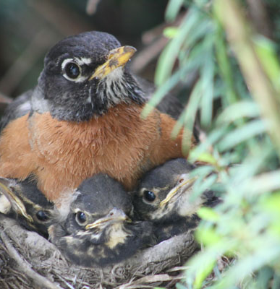
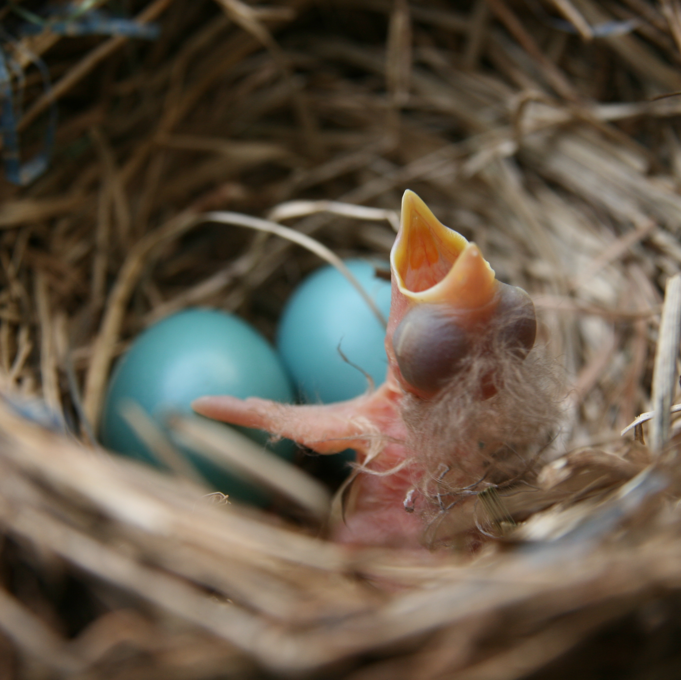
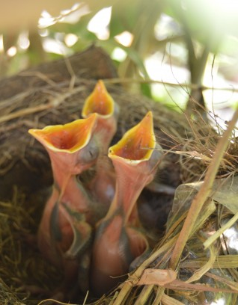

IECMH Considerations During the Global COVID-19 Pandemic
Kay Connors, LCSW-C, Instructor
Executive Director, Taghi Modarressi Center for Infant Study,
Child and Adolescent Psychiatry,
University of Maryland School of Medicine
SICC 2020
Notes:
Infant and early childhood mental health is the foundation of health and learning. Safe, stable and nurturing families, communities and programs are essential to optimal brain health and development. This workshop will provide evidence-based information, strategies and resources that health and education professionals can implement to help young children “grow well and grow love”.

Slide 2
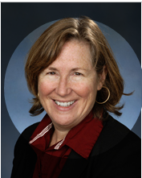
Today’s Speaker
Kay Connors, LCSW-C, is an instructor at the University of Maryland School of Medicine, Executive Director of the Taghi Modarressi Center for Infant Study, Director of the Center of Excellence for Infant and Early Childhood Mental Health and Maryland ACE Interface Trainer and Project Director, B-NEST, National Child Traumatic Stress Network Category III.
Ms. Connors is a clinical social worker who specializes in child and family traumatic stress and mental health. She provides clinical care and supervision and oversees workforce development and projects to improve access to high quality infant, child, adolescent and young adult mental health services
I would like to thank my colleagues, Janette Guerra, M.Ed. for this opportunity.

Slide 3

Our Team
  Sarah Edwards, DO, Assistant Professor, Assistant Division Director/Medical Director, Taghi Modarressi Center for Infant Study, /Center of Excellence for Infant and Early Childhood Mental Health
  Kay Connors, LCSW-C, Instructor, Executive Director, Taghi Modarressi Center for Infant Study, Director, Center of Excellence for Infant and Early Childhood Mental Health
  Brijan Fellows, LCSW-C, Clinical Program Director
  Carole Norris Shortle, LCSW-C, Clinical Assistant Professor, Master Clinician/Trainer
  Shanique Rogers, LCSW, Sailor Holobaugh, LCSW-C, Rhonda Jackson, LCPC, Sabrina MaIachi, LGPC, Ashley Nelson, LMSW ECMH Consultant, HealthySteps Specialists and Clinicians
  Ola Ibraheem, BA, Community Health Worker

Slide 4
Support
Center of Excellence for Infant and Early Childhood Mental Health
We are grateful for funding support from the Behavior Health Administration, Maryland Department of Health
We also receive funding from:
Department of Justice Programs Victim of Crime Assistance (VOCA) grant to respond to the needs of young children impacted by the Opioid Crisis
SAMHSA through National Child Traumatic Stress Initiative Category III Center

Slide 5
Reflections: How Are You Evolving During the Time of COVID?
Growth Mind Set
Learning Zone
Acclimate and Adapt
Survival Brain

Slide 6
The importance of social and emotional development in overall development and health.

Slide 7

Defining Early Childhood Mental Health
What do we mean? “behavioral,” “neurodevelopmental,” “psychiatric,” “psychological,” “emotional,” “social”, and impact of fetal substance exposure
Children under 6 and their primary caregivers, screening, assessment, brief intervention, referral and care coordination.
American Academy of Pediatrics, Committee on Psychosocial Aspects of Child and Family Health and Task Force on Mental Health. The future of pediatrics: mental health competencies for pediatric primary care. Pediatrics.2009;124(1):410–421
Notes:
he term “mental” throughout this statement is intended to encompass “behavioral,” “neurodevelopmental,” “psychiatric,” “psychological,” “emotional,” and “substance abuse,” as well as family context^{1–6} and community-related concerns such as child abuse and neglect, separation or divorce of parents, domestic violence, parental or family mental health issues, natural disasters, school crises, military deployment of children's loved ones, and the grief and loss accompanying any of these issues or the illness or death of family members. The term also encompasses somatic manifestations of mental health issues, such as eating disorders and functional gastrointestinal symptoms. This is not to suggest that the full range or severity of all mental health problems falls within the scope of pediatric primary care practice but, rather, that children and adolescents may suffer from the full range and severity of mental health conditions and psychosocial stressors. As such, children with mental health needs, similar to children with special physical and developmental needs, are children for whom pediatricians, family physicians, pediatric nurse practitioners, and physician assistants provide a medical home.⁷
The Diagnostic and Statistical Manual for Primary Care (DSM-PC) classification system⁸ distinguishes between developmental variations (behaviors that may raise concern but are within the range of expected behaviors for the age of the child), problems (behaviors serious enough to disrupt functioning but not to a level severe enough to warrant the diagnosis of a disorder), and disorders (as defined by the Diagnostic and Statistical Manual of Mental Disorders, Fourth Edition [DSM-IV]⁹). Because the PCC has a role in providing reassurance and/or care for children with behaviors in each of these categories, all fall within the scope of this document. Authors have used the term “concerns” when referring to behavioral issues not differentiated into 1 of these categories.
Many PCCs engage in mental health screening, assessment, diagnosis, and treatment. The term “mental health specialists” is intended to distinguish PCCs from those who specialize in the assessment and care of children and adolescents with mental health concerns. Thus, the term “mental health specialists,” as used in this report, includes physicians and nonphysicians such as psychiatrists, clinical psychologists, clinical social workers, licensed professional substance abuse counselors, nurses with advanced psychiatric training, family therapists, neurologists, early intervention specialists, developmental-behavioral pediatricians, and adolescent medicine specialists. Each of these disciplines has specific training and licensing requirements. Other individuals outside the mental health profession who have an effect on the mental health of children include teachers, counselors, coaches, religious leaders, and community and extended family members. Providers of complementary and alternative (integrative) medicine (CAM), both licensed and unlicensed, also may address children's mental health, and a large number of families self-select CAM treatments for their children's mental health conditions.^{10–14} A growing body of literature describes the potential benefits of CAM approaches^{15–17} and risks of CAM therapies, including interactions of herbal remedies and dietary supplements with prescription medications.^{18,19}Although 1 randomized, controlled trial of St John's wort was conducted with adolescents with depression,^{20,21} most studies of herbal medication for mental health disorders have been completed in adults. These developments underscore the importance of knowing the medical evidence and considering CAM therapies and CAM providers in the context of pediatric mental health care.

Slide 8
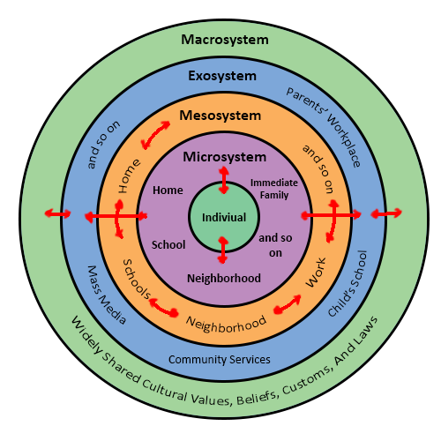
Ecological Approach to Development
Urie Bronfenbrenner theory/foundation of Head Start model
Individual’s relationship within her/his social context
Development occurs over time in a set of overlapping ecological systems
Systems and interactions within and across them influence who the person becomes
Notes:
A theory of development that stresses the importance of understanding not only the relationships between the organism and various environmental systems but the relations between such systems themselves.
Development that is adaptive in one context may be maladaptive in another context
Development occurs within nested (ecological) contexts (i.e., Bronfenbrenner)
Development arises from a dynamic interplay of physiological, genetic, social, cognitive, emotional, and cultural influences across time

Slide 9
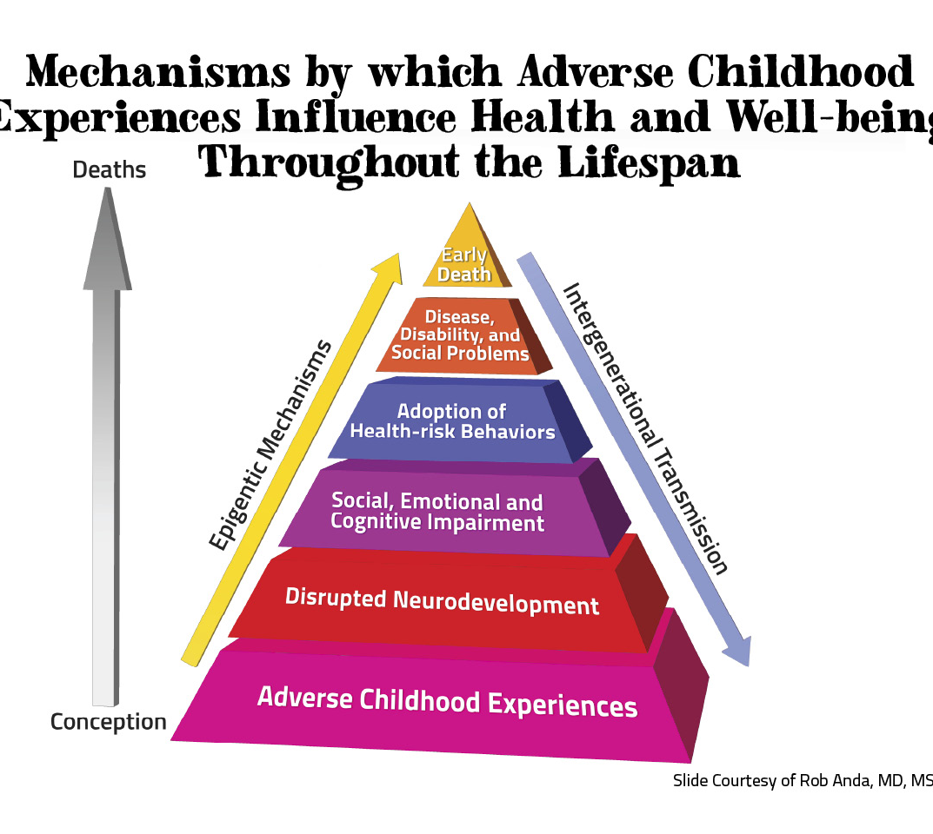
ACE Study:
http://www.cdc.gov/nccdphp/ace/

Slide 10
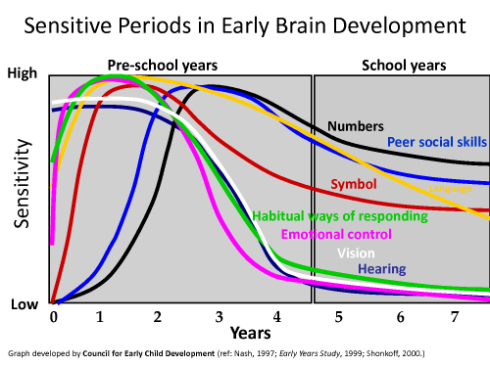
‘Sensitive Slopes’ of Brain Development

Slide 11

Brain Development
Brain adapts to the environment
Great capacity to change
Vulnerability to mental illness—and resilience—is rooted in development.
Both risk and resilience are shaped by genes and environment interacting together, through childhood and adolescence
-http://nimh.nih.gov/health/topics/child-and-adolescent-mental-health/index.shtml
Notes:
Researchers are tracing how changes in the developing brain underlie milestones in a child’s mental and physical abilities, and behavior.

Slide 12
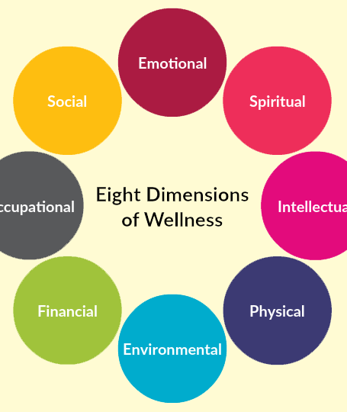
Early Childhood Development: Not Only School Readiness
  Foundation for health and human capacity
  Long period to grow and program the brain for successful adaptation to the environment and culture
  Exceptional capacity to learn and critical period for relational, social and emotional development
  “No health without mental health”-World Health Organization

Slide 13

Role of Attachment
Protection
Regulation
Learning
Blueprint for relationships
  “Purpose is not a produce a certain type of child but to engage in meaningful and profound relationships”
  -Gopnik, Alison. “Against Parenting.” July 9-10, 2016. Wall Street Journal. Adapted for “The Gardner and the Carpenter: What the New Science of Child Development Tells Us About the Relationship Between Parents and Children.”
Notes:
We can’t learn and fend for ourselves at the same time
“We argue that infant mental health problems emerge when the meanings infants make in the moment, which increase their complexity and coherence and may be adaptive in the short run, selectively limit their subsequent engagement with the world and, in turn, the growth of their state of consciousness in the long run.” ……”When chronic and iterative, these altered meanings can interfere with infants’ successful development and heighten their vulnerability to pathological outcomes.”

Slide 14
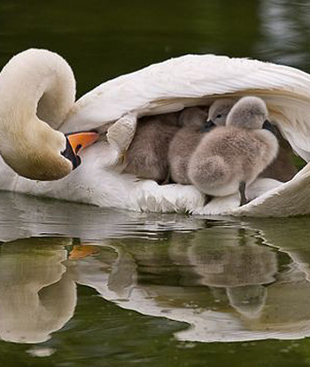
Grow Well & Love Well
Early childhood mental health is defined as the capacity to "grow well and love well."
1) experience, tolerate and express a range of emotions without lasting emotional collapse;
2) form and maintain mostly trusting and intimate relationships; and
3) learn the culturally expected skills considered appropriate for the child's age.
-Alicia Lieberman and Patricia Van Horn, 2008.
Notes:
Essential: These first blocks of slides is making the case for IMH

Slide 15
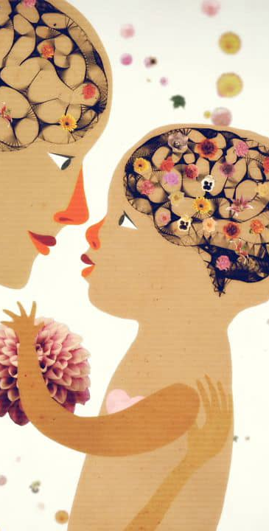
Two Generation Resources for Coping with COVID-19 Pandemic
Dyad
Parent
Child

Slide 16
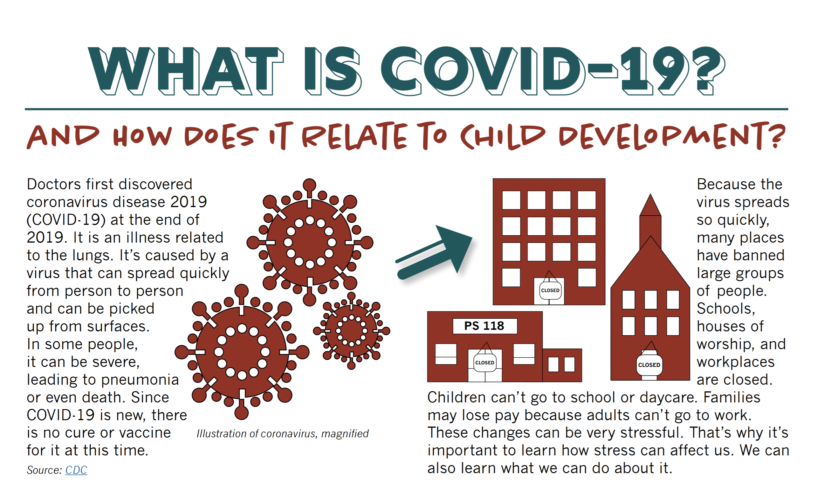
https://developingchild.harvard.edu/resources/what-is-covid-19-and-how-does-it-relate-to-child-development/

Slide 17
Developmental Screening
Detection rates of developmental disorders lower than prevalence rates
Identification of delayed or disordered development promotes identification of
  Specific medical conditions
  Risk for other medical complications
  Risk for associated behavioral or other developmental disorders
  Appropriate treatment plan
  Appropriate early intervention services
  Appropriate family counseling regarding expectations and for family planning reasons
          AAP Pediatrics 2006

Slide 18
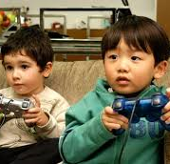
Anticipatory Guidance
General Recommendations
  Sleep hygiene
  Nutrition
  1:1 attention
  Limited TV/Video
  Caution on video violence
  Increase outdoor time
Bright Futures: Promoting Mental Health

Slide 19

Tips for Successful Video Visits
Make it a social, interactive experience.
Use props
Be the “hands and heart” of the person on-screen
Explain any technical difficulties
Let children take the lead with the technology as they grow
https://www.zerotothree.org/resources/2535-five-tips-to-make-the-most-of-video-chats
Notes:
Follow the lead of our military families and grandparents

Slide 20
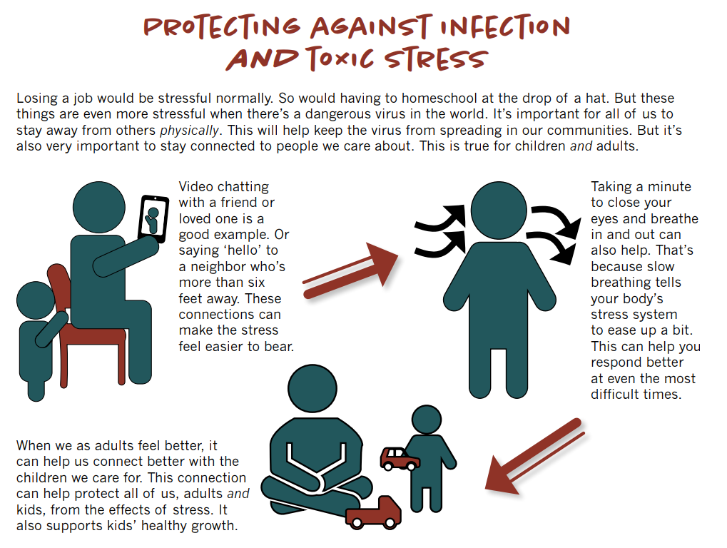

Slide 21
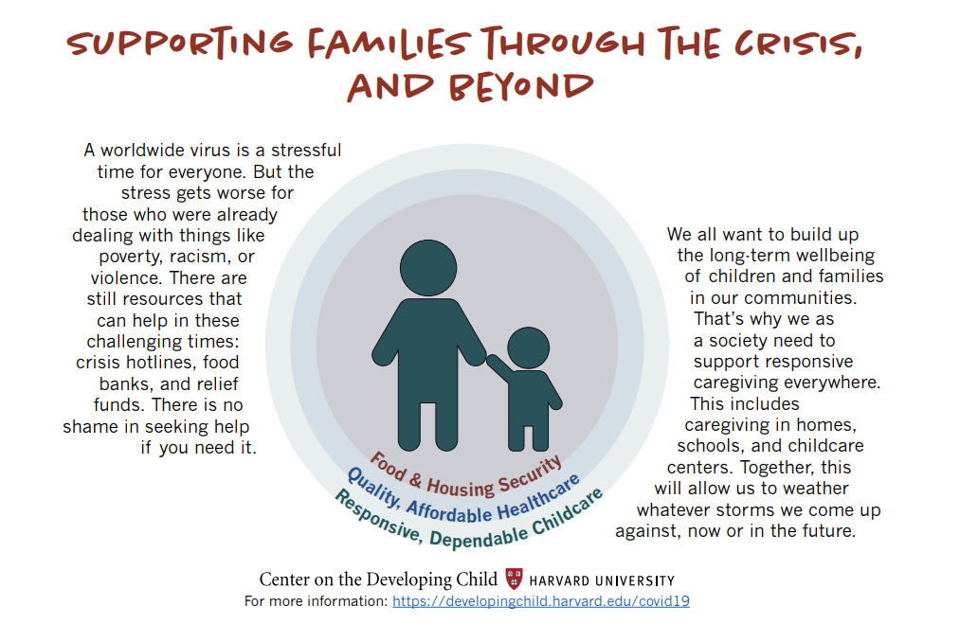

Slide 22

Safety
Address concerns about physical safety (housing, domestic violence) and basic needs (food, etc.).
Problem solve how to meet those safety needs.
Resources: Maryland 211

Slide 23
Child Abuse in Disasters
Emergencies and natural disasters escalate the risk due to weakened child protection systems and disruption of preventative mechanisms
Reported rate of violence is less than the actual rate due to lack of required infrastructure and reporting mechanisms.
Seddighi H, Salmani I, Javadi MH, Seddighi S. Child Abuse in Natural Disasters and Conflicts: A Systematic Review [published online ahead of print, 2019 Mar 13]. Trauma Violence Abuse. 2019;1524838019835973. doi:10.1177/1524838019835973
Notes:
Violence against children affects a significant portion of youth around the world. Emergencies and natural disasters escalate the risk due to weakened child protection systems and disruption of preventative mechanisms. In this systematic review, 692 related papers were searched in various databases in the initial search. After review, 11 papers were finally selected for full review. These papers were selected based on publication date, relevance to emergencies, their geographical area type of violence, age of subjects, and their gender. Most families affected by natural disasters, especially those in lower socioeconomic status, face greater social and economic pressures. The families that are more vulnerable to loss of food and shelter commit violence against children more frequently. On the other hand, while the rate of violence increases in emergencies, the reported rate of violence is less than the actual rate due to lack of required infrastructure and reporting mechanisms. The emergency housing increased risk of some types of child abuse. The history of exposure to violence, parental substance abuse, poverty, and child labor were predictors of increased violence against children in emergency situations. Sexual violence against girls after conflicts and physical violence against boys after emergencies are common forms of violence. Poverty as another predictor exposes children to more violence due to limited family economic resources and support. Given the identified predictors of violence, humanitarian organizations can come closer to providing appropriate plans to reduce the risk during and postdisaster.

Slide 24

Emotional Safety
Emotional Safety
Knowing how you feel is important to staying well. It can also decrease family conflict, violence and thoughts or actions to harm yourself.
If concerns regarding family violence or suicide arise, please talk to someone you trust and who will listen and call one of the hotlines or 911.

Slide 25

Coping
It is essential for parents to take care of yourself so that you can be there for your family.
Look for signs of stress in yourself and in your children.
Routines can help everyone stay in touch and reduce stress. If the ones you have in place are working, stick to them, if not create new ones for this special time.
Visit the MSDE Parent Toolkit for more information http://www.marylandpublicschools.org/programs/Documents/ITSLM/ParentResources.pdf?fbclid=IwAR0WdxNFpf7k1OQVr_IzBNlCDKz2MBUQwvbbadMT6CABEOJClLRdnsJwL48

Slide 26
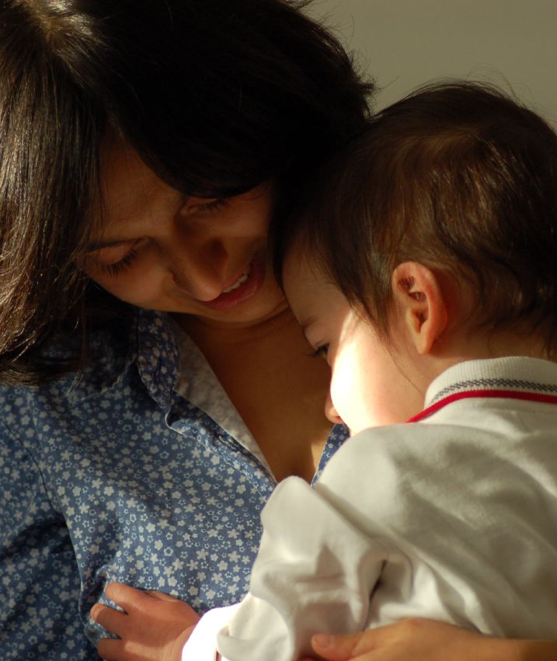
Meaning Making
Need for Whole Family Care and Two-generational approaches
“Infants make meaning about themselves and their relation to the world of people and things”
Tronick, E. & Beeghly, M. (2011).
Notes:
Shapes how they engage with the world.
Lester, B. M., Tronick, E., Nestler, E., Abel, T., Kosofsky, B., Kuzawa, C. W., ... & Wood, M. A. (2011). Behavioral epigenetics.Annals of the New York Academy of Sciences,1226(1), 14-33.
Tronick, E. & Beeghly, M. (2011). “ Infant’s Meaning Making and the Development of Mental Health Problems.” Am Psychology, 66(2): 107-119.
“Some infants may come to make meaning of themselves as helpless and hopeless, …. Others seem to feel threatened by the world and may become hyper-vigilant and anxious.”
Tronick, E. & Beeghly, M. (2011).

Slide 27
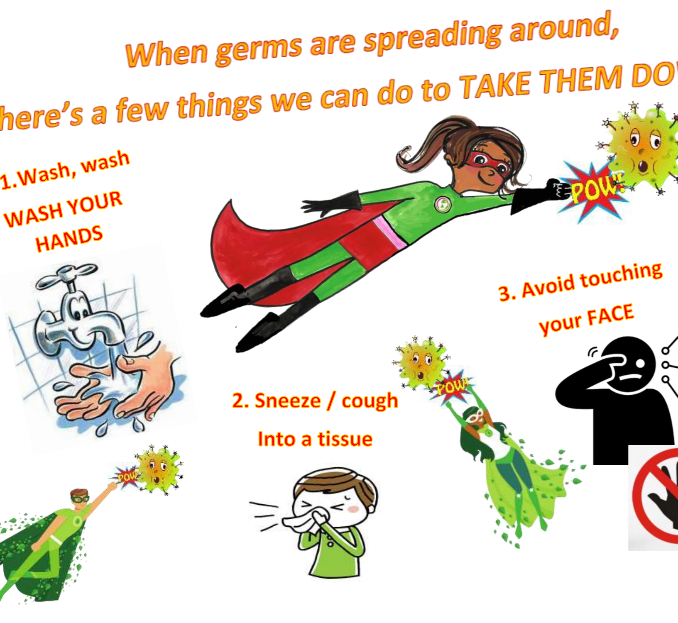
Coping
Talk with children and explain why things are different.
Be sure not to scare them.
Remind them that many people are helping out.
Children can be helpers too by washing their hands, adhering to social distancing rules and following all health and safety rules.

Slide 28
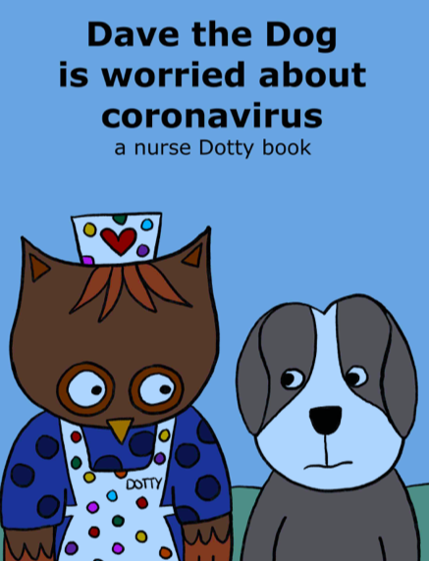

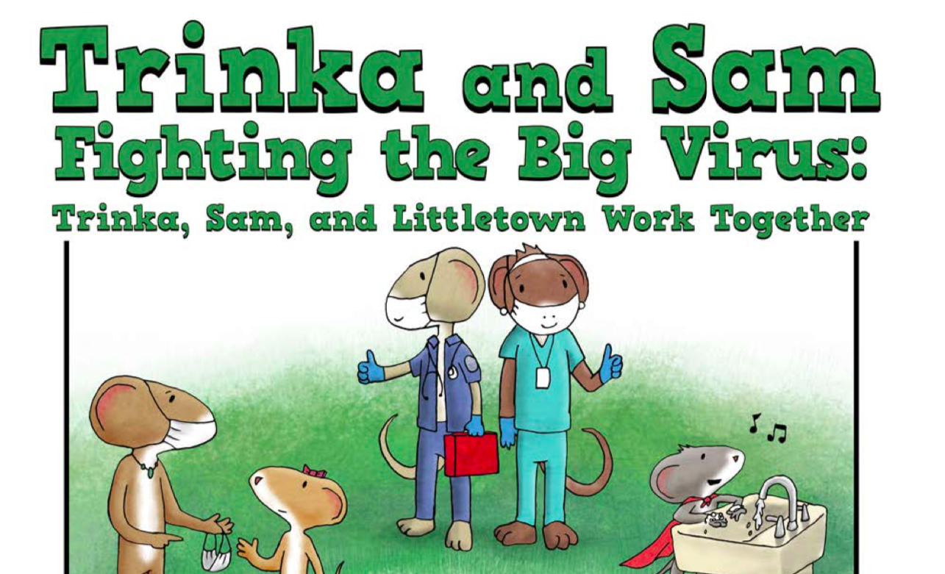
DAVE THE DOG IS WORRIED ABOUT CORONAVIRUS
MY 2020 COVID-19 TIME CAPSULE
TRINKA AND SAM FIGHTING THE BIG VIRUS

Slide 29

Coping
“Name it to Tame it”
No one needs to be perfect.
Parents and child have understandable fears and worries.
Talking and listening are powerful.

Slide 30
Telehealth Stories to Create Meaning during COVID Outbreak
Fear of pain
Fear of loss (separation anxiety)
Fear of losing love and approval
Fear of body damage
Fear of being bad/social disapproval
Notes:
Telehealth Story
Fear of getting sick
Fear of being Bad-Out of School (JM)
Discuss range of stress and need to evaluate family level needs
Family impacted by opioid crisis
In recovery mother learned about consistently but that is not the port of entry. Instead emotional process and discuss of empathy and guilt was more impactful
Engagement around tolerable stress and need for resources for deaf child (age 5) and how social isolation is creating a situation where mother feels guilty and gives to demands for tech and child becomes more relationally distant with use of tech and mother finds it hard to set limits

Slide 31

Coping
What Kids Need
To feel loved and protected
To understand
To know their feelings
To feel capable

Slide 32

E-Book for Kids
I have a question about Coronavirus: https://28638781-c0c7-460f-81ae-fa6eba3486b9.filesusr.com/ugd/517d15_915f31f39df449a2837c11862a7ab39c.pdf
Sesame Street:
https://www.sesamestreet.org/caring
Piplo Productions: http://piploproductions.com/
Fighting the Big Virus: Trinka, Sam, and Littletown Work Together
The story opens doors to conversations about family and community strengths, challenges and feelings related to COVID-19, ways grown-ups help children keep safe, and our gratitude for frontline workers.
http://piploproductions.com/trinka-and-sam-virus/

Slide 33
COVID related Child Resources
ZERO TO THREE
  https://www.zerotothree.org/resources/3210-tips-for-families-coronavirus
BHIPP COVID related resources
  https://mdbhipp.org/covid-19-resources.html
Children’s Mental Health Matters
  https://www.childrensmentalhealthmatters.org/resources/coronavirus/
National Center of School Mental Health’s resources
  http://www.schoolmentalhealth.org/COVID-19-Resources/
Child care announcements and resources
  https://earlychildhood.marylandpublicschools.org/
Maryland Pyramid Model- Social Emotional Early Learning Community
  www.mdpyramidmodelsefel.org
National Child Traumatic Stress Network
  https://www.nctsn.org/resources/parent-caregiver-guide-to-helping-families-cope-with-the-coronavirus-disease-2019

Slide 34
Resources for COVID-19 and Mental Health
Maryland 211
  Dial 211 for help or visit https://211md.org
Maryland Chapter of National Alliance on Mental Illness
  http://namimd.org
Maryland Department of Health
  coronavirus.maryland.gov
  https://odhh.maryland.gov/coronavirus/ (deaf and hard of hearing)
Maryland Children’s Alliance Inc.
  www.marylandchildrensalliance.org
Maryland Network Against Domestic Violence
  www.mnadv.org
  301-352-4574 or 1-800-MD-HELPS
Maryland Network Against Domestic Violence
TOLL-FREE: 800-MD-HELPS
Phone: 301-352-4574
http://www.mnadv.org
House of Ruth: 410-889-7884 (RUTH)
http://www.hruth.org
Centers for Disease Control and Prevention
  https://www.cdc.gov/coronavirus
U.S. Substance Abuse and Mental Health Services Administration (SAMHSA)- information, disaster hotline, military and veterans hotline
  https://samhsa.gov/find-treatment
National Suicide Prevention Lifeline
  800-273-TALK (8255)
  NATIONAL DOMESTIC VIOLENCE HOTLINE
  1-800-799-7233

Slide 35

Resources for ACE
Center for Disease Control
  ACE https://www.cdc.gov/violenceprevention/childabuseandneglect/acestudy/index.html
  Essential for Childhood https://www.cdc.gov/violenceprevention/pdf/essentials-for-childhood-framework508.pdf
  ACE Connections

Slide 36
Follow Us…
Center of Excellence on Facebook and Twitter Facebook page is
www.facebook.com/iECMHMaryland
and @InfantMd Twitter
New ECMH webpage on the National for School Mental Health
http://www.schoolmentalhealth.org/COVID-19-Resources/

Slide 37
Questions?
Kay Connors, LCSW-C
University of Maryland School of Medicine
410-706-3216
kconnors@som.umaryland.edu

